Slide 1
Electrical Machines
DC Generator and Motor
Prepared by,
Dr. M. Arun Noyal Doss,
Associate Professor,
EEE, SRM University

Slide 2
Electrical Machines
Electrical Machine is a device which converts one form of energy into another form

Slide 3
Classification of Electrical Machines
Electrical Machines
Static
Transformer
Rotating
DC Machines
AC Machines
Generators
Motors
Generators
Motors
Induction
Synchronous
Induction
Synchronous

Slide 4
Generators
Function:
Generators are the electrical machines which convert mechanical energy into electrical energy.
GENERATOR
Mechanical
Energy
Electrical
Energy

Slide 5
Generators
Working Principle
It works on the principle of Faraday’s laws of electromagnetic induction.
Whenever a conductor cuts the magnetic field, an emf is induced and current flows when the conductor is connected to a load.
The direction of induced emf can be found using Fleming’s Right Hand Rule

Slide 6
Direction of Induced emf- Fleming’s Right Hand Rule Or Generator Rule
FORE FINGER = MAGNETIC FIELD
90⁰
90⁰
Thumb = Conductor
90⁰
MIDDLE FINGER = INDUCED
VOLTAGE

Slide 7
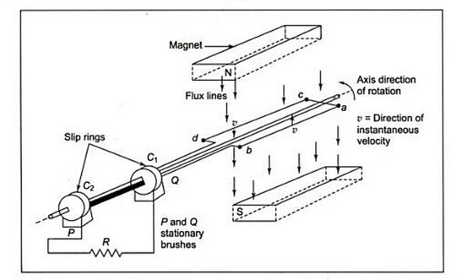
Illustration of Working Principle of DC Generator using a single turn generator
Conductor
Permanent Magnet – Flux Lines
Prime Mover- to rotate the conductor

Slide 8
Generators
Working Principle
Can be explained using velocity components

Slide 9
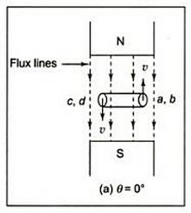
Generators-Working Principle
Case I: θ=0º
The velocity component (v) is in parallel with the flux lines or in other words, the angle between the velocity and flux lines is zero.
Hence the emf induced is zero.
E=0

Slide 10
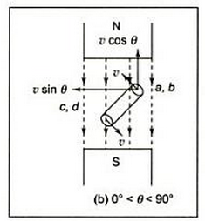
Generators-Working Principle
Case II: 0º< θ < 90º
The velocity component is making an angle with the flux lines.
The velocity component is resolved into two components
vsinθ
Vcosθ
vcosθ is making 0º with respect to flux lines and is not doing any useful work.
The vsinθ is 90º with respect to flux lines and it is doing useful work and due to this, emf is induced.
e_{min}<e<e_{max}

Slide 11
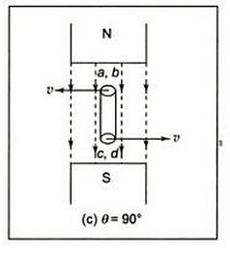
Generators-Working Principle
Case III: θ = 90º
The velocity component is making an angle 90º with the flux lines.
and due to this, emf is induced.
E=e_{max}

Slide 12
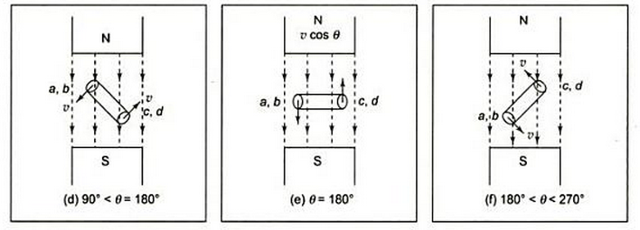
Generators-Working Principle
For remaining cases, the illustration is shown below,
The emf completes one complete cycle for 360º .

Slide 13
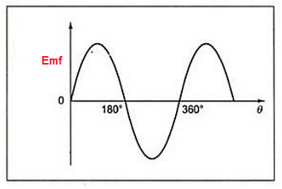
Emf induced across the Brush
Emf induced is the alternating type
BECAUSE
during positive half cycle, the conductor comes under the influence of north pole
during negative half cycle, the conductor comes under the influence of south pole

Slide 14
How to convert AC to DC?
It is observed that the emf induced is the alternating type, but it is required to obtain unidirectional emf from the DC machines.
The alternating emf can be converted into pulsating dc using the split ring/commutator.

Slide 15
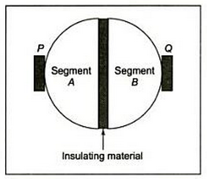
Commutators
Copper Segments

Slide 16
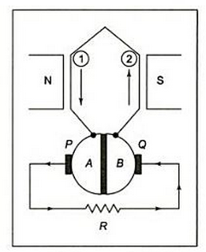
Action of Commutators
During positive half cycle, A segment will be at P and B will be at Q.

Slide 17
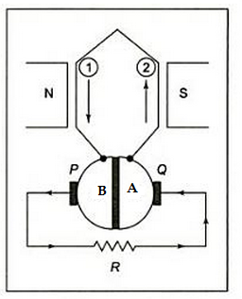
Action of Commutators
During negative half cycle, the time at which the current changes the direction, the segment A will move to Q and B will move to P.

Slide 18
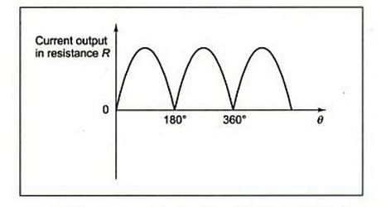
Action of Commutator
The leads to unidirectional current.

Slide 19
Practical DC Generator
The Major Parts of DC generator are
Stationary Parts
Rotating Parts

Slide 20
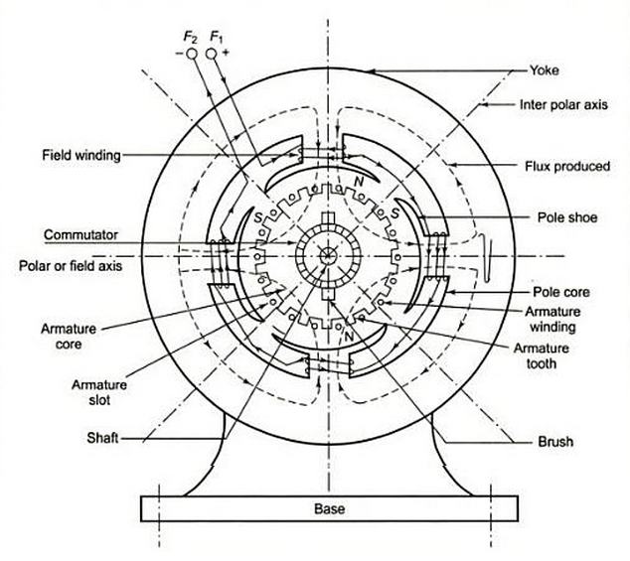
Practical DC Generator

Slide 21
Practical DC Generator
Stationary Parts
Yoke: Outermost Frame for protection, Mechanical Support to the machine and protects inner parts
Poles
Field Windings: This is used to carry field current so it produces the magnetic flux
Pole Shoe: Horse shoe shape to spread the flux uniformly in the air gap

Slide 22
Practical DC Generator
Rotating Parts
Armature
Slots: cut portion
Armature Conductors are placed on the slots
Teeth: uncut Portion
Commutator: Converts alternating (bidirectional) emf into pulsating dc emf (unidirectional)
Brush: collect current from the machine and give to a load.

Slide 23
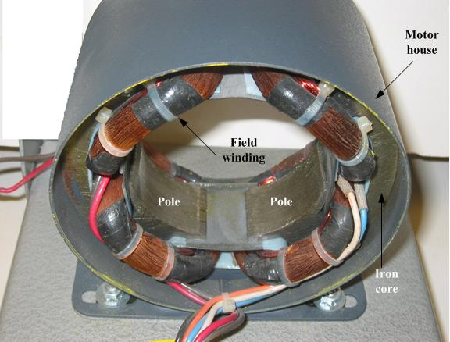
Stationary Part

Slide 24
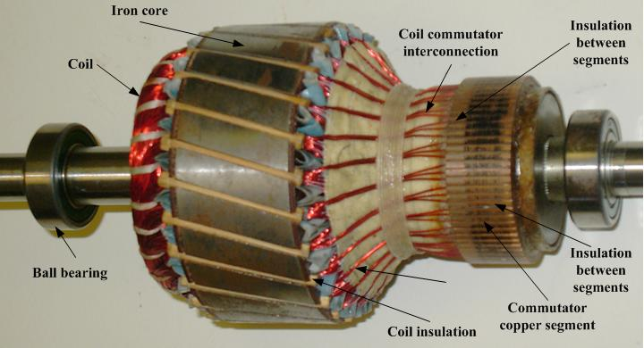
Rotating Part-Armature

Slide 25
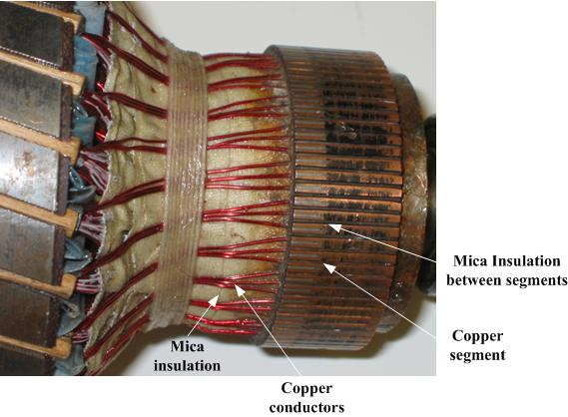
Rotating Part-Armature (Closer View)

Slide 26
Types of Generator
DC Generators
Separately Excited
Self Excited
Shunt
Series
Compound
Long
Short
Differential
Cumulative
Differential
Cumulative

Slide 27
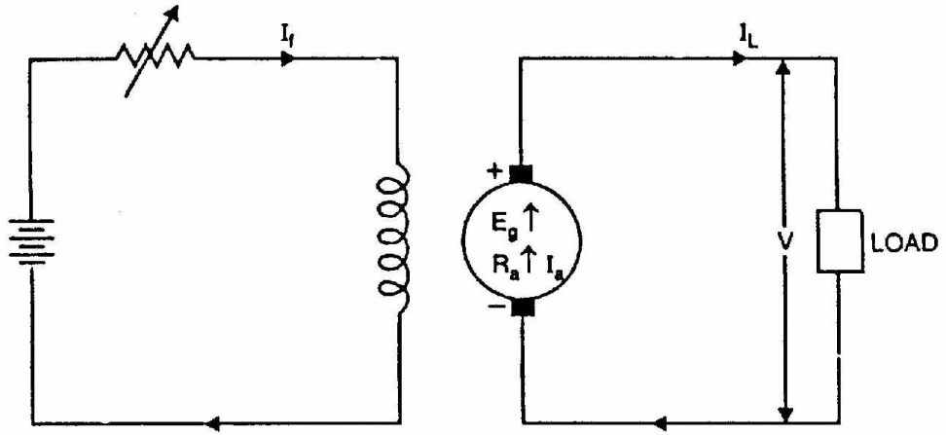
Separately Excited
Armature Current
I_{a} = I_{L}
Emf Equation
E_{g} = V + I_{a} R_{a} + V_{b}
V_{b}=brush drop for pair of brush

Slide 28
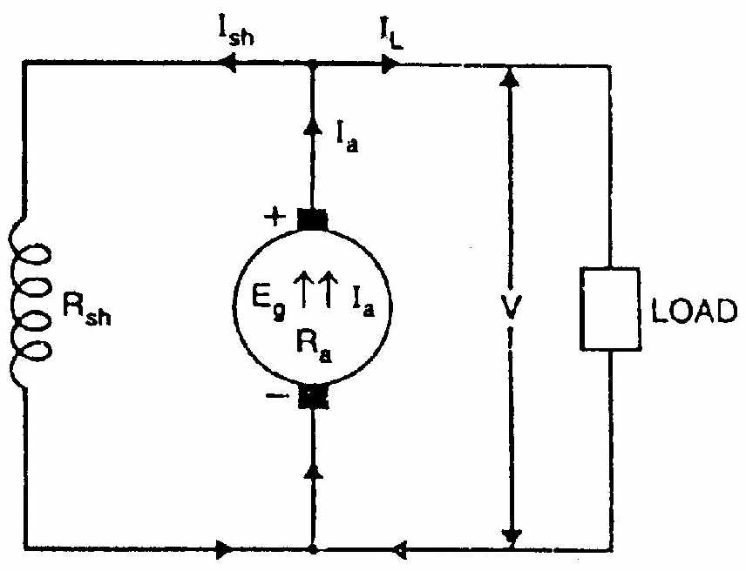
Self Excited Shunt
Armature Current
I_{a} = I_{L} + I_{sh}
Shunt Field Current
I_{sh} = V/R_{sh}
Emf Equation
E_{g} = V + I_{a} R_{a} + V_{b}

Slide 29
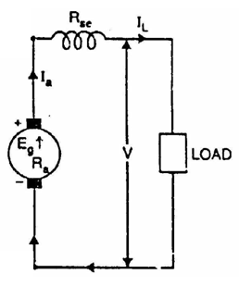
Series
Armature Current
I_{a} = I_{L} = I_{se}
I_{a} = I_{se} =I_{L} = V/R_{se}
Emf Equation
E_{g} = V + I_{a} R_{a} + I_{a} R_{se} + V_{b}

Slide 30
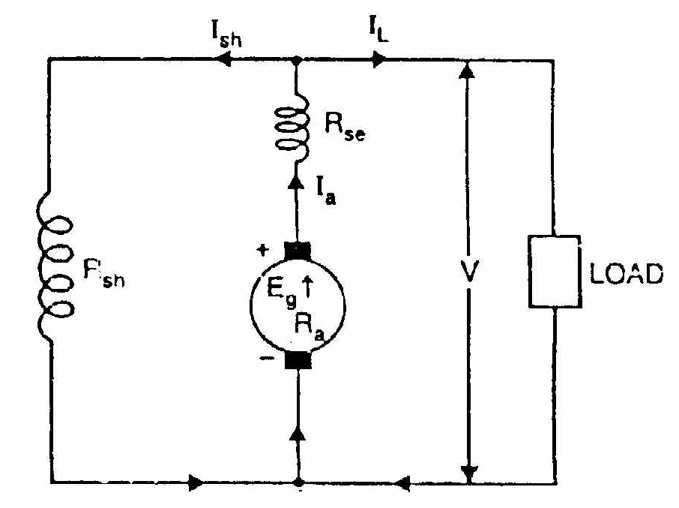
Long Shunt
Series Field Current
I_{se} = I_{a} = I_{L} + I_{sh}
Shunt Field Current
I_{sh} = V/R_{sh}
Emf Equation
E_{g} = V + I_{a} R_{a} + I_{a} R_{se} + V_{b}

Slide 31
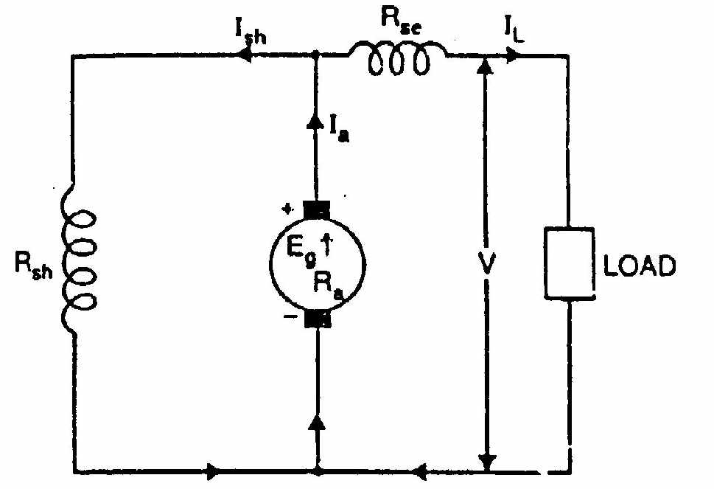
Short Shunt
Series Field Current
I_{se} = I_{L}
Shunt Field Current
I_{sh} = (V + I_{se} R_{se})/R_{sh}
Emf Equation
E_{g} = V + I_{a} R_{a} + I_{se} R_{se} + V_{b}
I_{se}

Slide 32
Characteristics of generators
Open Circuit Characteristics (If, Eg0)
Load Characteristics
Internal (Ia, Eg)
External (VL, IL)

Slide 33
Characteristics of Self excited DC Generator

Slide 34
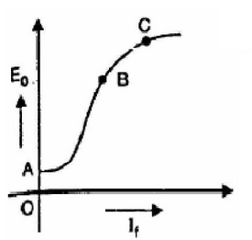
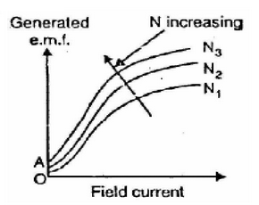
Open circuit characteristics-Self excited

Slide 35
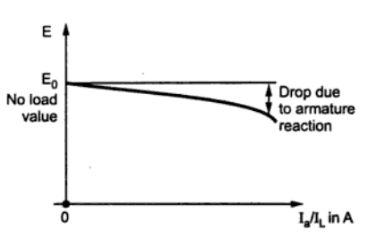
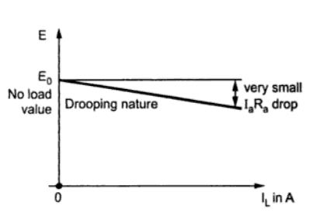
External Characteristics of Self excited dc generator

Slide 36
Open circuit characteristics of separately excited DC generator
Similar to self
Difference
voltage build up process is due to both residual magnetism and dc source.

Slide 37
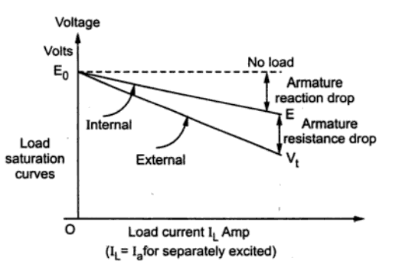
External Characteristics of Seperately excited
Same as self

Slide 38
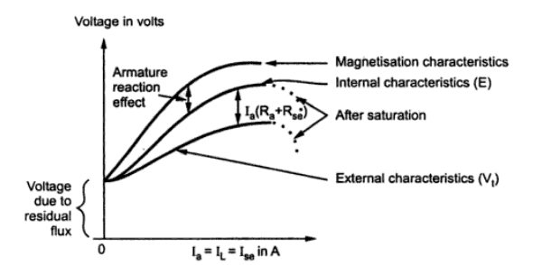
Characteristics of Series generator

Slide 39
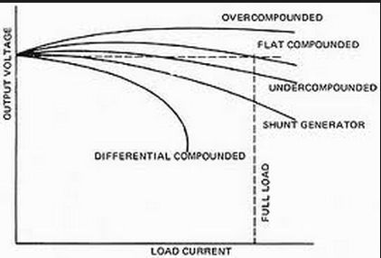
Characteristics of compound generator (long or short)

Slide 40
Armature Reaction
The interaction of armature flux with field flux is called as armature reaction.
As long as the armature is not connected with the load, there is no armature reaction
When the load is connected to the armature, the current flows in the armature and it produces armature flux. This interacts with the field flux. This is armature reaction.

Slide 41
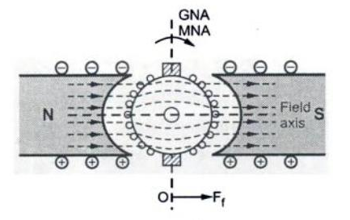
Case 1: only field flux, no armature flux
MNA (magnetic neutral axis), GNA (geometric neutral axis) coincides
with each other

Slide 42
MNA and GNA
MNA: magnetic neutral axis- axis along which there is zero emf. (Commutation axis)
GNA: Geometric neutral axis: axis of symmetry between the poles.

Slide 43
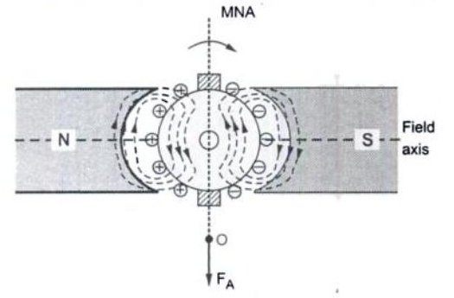
Case 2: no field, only armature flux
MNA (magnetic neutral axis), GNA (geometric neutral axis) coincides
with each other

Slide 44
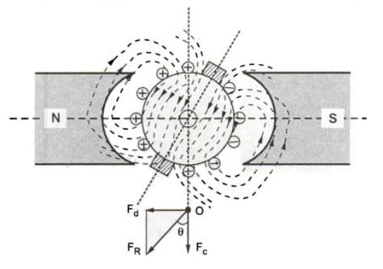
Case 3: Both field and armature flux
GNA
MNA
F_{d}
F_{f}
F_{A}
Fd-Demagnetising flux opposes Ff
Fc-Cross magnetising perpendicular to Ff
Fc

Slide 45
Armature reaction
De-magnetising field reduces the magnitude of field flux so that it reduces the net flux.
Cross magnetizing field distorts the field flux.

Slide 46
MOTORS
Function:
Motors are the electrical machines which convert electrical energy into mechanical energy.
MOTORS
Electrical
Energy
Mechanical
Energy

Slide 47
Motors
Working Principle
Whenever a current carrying conductor is placed in a magnetic field, the conductor experiences a mechanical force.
The direction of induced emf can be found using Fleming’s left Hand Rule

Slide 48
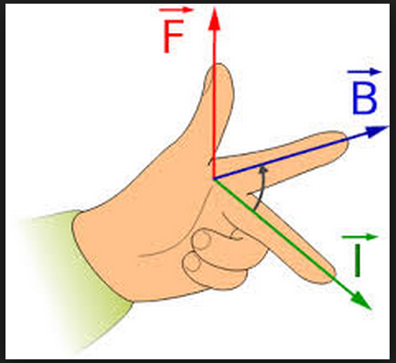
Direction of force- Fleming’s left Hand Rule Or motor Rule

Slide 49
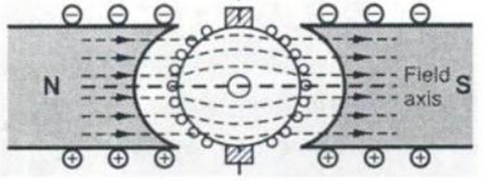
Illustration of Working Principle of DC Motor
Case I
No torque

Slide 50
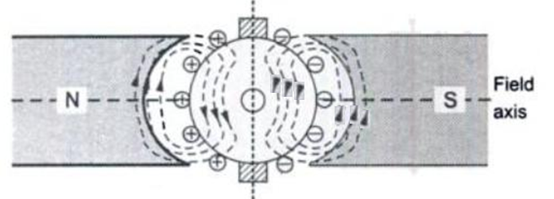
Illustration of Working Principle of DC Motor
Case II
No torque

Slide 51
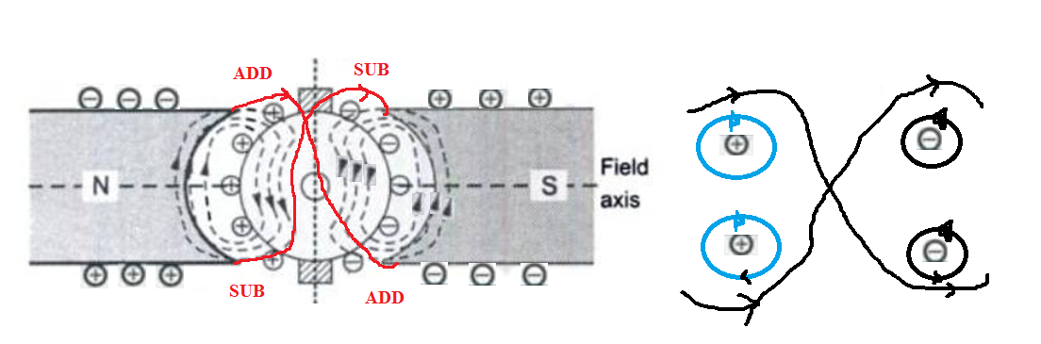
Illustration of Working Principle of DC Motor
Case III
Torque, motor rotates in anticlockwise direction

Slide 52
Types of Motor
DC Motors
Separately Excited
Self Excited
Shunt
Series
Compound
Long
Short
Differential
Cumulative
Differential
Cumulative

Slide 53
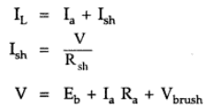
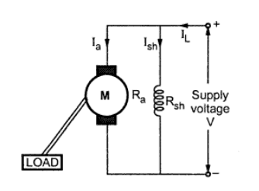
Shunt Motor and back emf
V>E_{b}
Back emf opposes the applied voltage
N is small, E_{b} is less, I_{a} increases
As N increases, E_{b} increases,
I_{a} decreases
E_{b}-acts as self governor

Slide 54
Back emf
Back EMF – it makes the motor to draw required amount of current from the supply.

Slide 55
Characteristics of motor
Electrical (Ia, Ta)
Mechanical (Ia,N) and (Ta, N)

Slide 56
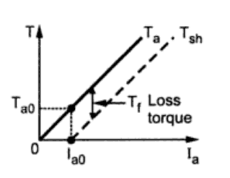
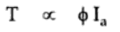
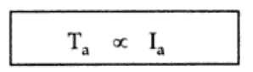
Shunt motor (Ta,Ia)

Slide 57
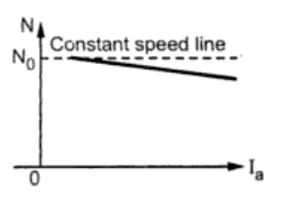
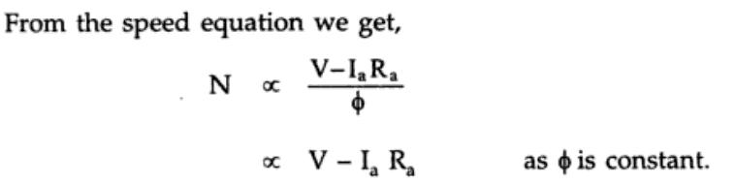
Shunt motor – (Ia,N)

Slide 58
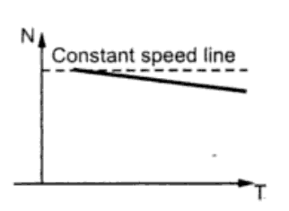
Shunt motor-(Ta,N)

Slide 59
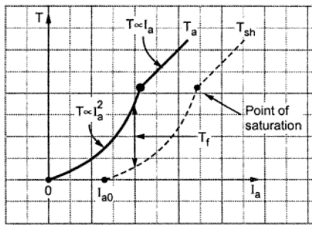
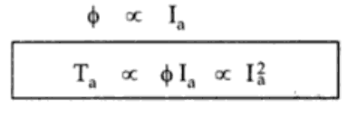
Series motor

Slide 60
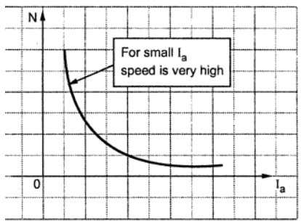
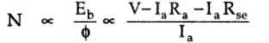
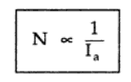
Series motor
V is constant
Series motor cannot be
Started with no load.

Slide 61
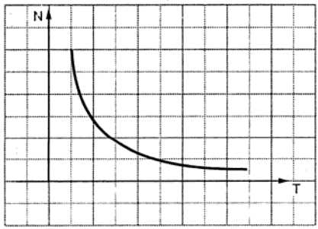
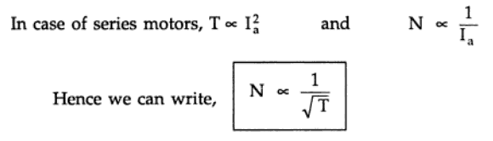
Series motor

Slide 62
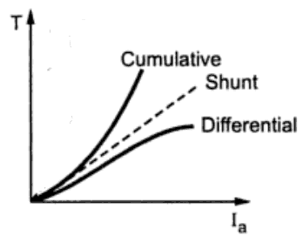
Compound motors

Slide 63
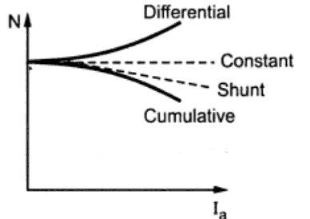
Compound motors

Slide 64

Compound motors

Slide 65

Applications

Slide 66

Applications

Slide 67
Starters
Need
Starters are used to reduce initial high current

Slide 68
Why motor draws high current during starting?
At start Back emf is zero, Ia is large

Slide 69


Slide 72


Slide 74


Slide 76


Slide 79



Slide 80


Slide 82


Slide 83
Induction Machines
Electrical Machine is a device which converts one form of energy into another form

Slide 84
Classification of Electrical Machines
Electrical Machines
Static
Transformer
Rotating
DC Machines
AC Machines
Generators
Motors
Generators
Motors
Induction
Synchronous
Induction
Synchronous

Slide 85
Introduction-construction
Stator
Slots are present
In the slots, conductors are placed which are connected together to form windings
Three phase windings are connected in star or delta.
The stator core is laminated to avoid eddy current loss.
The material chosen is silicon steel.

Slide 86




Construction (Stator construction)
The stator is the stationary electrical part of the motor.
The stator core of a National Electrical Manufacturers Association (NEMA) motor is made up of several hundred thin laminations.
Stator laminations are stacked together forming a hollow cylinder. Coils of insulated wire are inserted into slots of the stator core.
Electromagnetism is the principle behind motor operation. Each grouping of coils, together with the steel core it surrounds, form an electromagnet. The stator windings are connected directly to the power source.

Slide 87
Construction (Rotor construction)
Induction motor rotor types:
Squirrel cage type:
Rotor winding is composed of copper bars embedded in the rotor slots and shorted at both end by end rings
Simple, low cost, robust, low maintenance
Wound rotor type:
Rotor winding is wound by wires. The winding terminals can be connected to external circuits through slip rings and brushes.
Easy to control speed, more expensive.

Slide 88


Construction (Rotor construction Squirrel cage)

Slide 89


Slide 90


Slide 91

Squirrel Cage

Slide 92

Squirrel Cage
Short circuits all
rotor bars.
/rotor winding

Slide 93

Slip ring rotor

Slide 94

Slip ring rotor

Slide 95

Comparison

Slide 96
Working principle
Current carrying conductor placed in a magnetic field experiences a force.
The two magnetic fields interact with each other to produce mechanical force.

Slide 97
Working principle
The stator windings are supplied with three phase AC supply.
The rotating magnetic field is produced which rotates with synchronous speed with the constant magnitude of 1.5φ_{m.}
The rotating magnetic field sweeps the rotor surface.
The emf is induced in the rotor.
The rotor bars are short circuited and hence current flows in the bars.

Slide 98
Working principle
The current carrying conductor produces rotor magnetic field which interact with stator magnetic field to produce torque.

Slide 99

Rotating magnetic field

Slide 100
Rotating Magnetic Field
The RMF rotates with the magnitude of 1.5ɸ_{m} and with the speed of synchronous speed which is given by Ns=120f/p, where f is the frequency and p is the number of poles.

Slide 101
Synchronous Motor
Constant speed, always run at synchronous speed
Construction similar to alternator.

Slide 102

Synchronous motor

Slide 103

Not self Starting motor-Why

Slide 104
Working Principle
Magnetic Locking Principle

Slide 105

Magnetically locked and runs

Slide 106
Procedure to start
Apply Three phase supply
Rotate the rotor using external means and bring the speed of the motor near to the synchronous speed.
Give dc excitation to the field winding of the rotor
At particular instant, the rotor gets locked with the stator and runs with synchronous speed.
Then the external means is disconnected.

Slide 107
External Means
Ponny Motors-Induction motor
Damper winding
Small DC Motor

Slide 113
CHARACTERISTICS | SINGLE PHASE INDUCTION MOTOR | THREE PHASE INDUCTION MOTOR
Power Source | Single Phase (1-phase) Only | Generally requires more than a single phase power source (like 3-phase supply).
Starting Mechanism | They are NOT self-starting. | They are self-starting.
Efficiency | Low as only one winding has to carry all the current | High because three winding are available to carry the current
Types | Shaded pole Split Phase Capacitor Start Inductor Run Capacitor Start Capacitor Run | Squirrel cage type Slip ring type or wound induction motor
Cost | Cheaper | Quite Expensive
Slip (s) | There are two slips: Forward slip (s) Backward slip (2-s) | It has only forward slip
Size (for same power rating) | Larger in size | Smaller in size
Power Factor | Low | High
Repair & Maintenance | Easier to repair | Difficult to repair and maintain
Structure | Simple and easy to manufacture | More complicated to construct because of extra components involvement
Starting Torque | Low | High
Operational Reliability | More Reliable | Less Reliable
Motor Rotation | There is no mechanism to change the rotation. | Can be changed easily by changing the phase sequence in stator.

Slide 114
Applications:
Frequently used for lighter loads. such as: Blowers Vacuum cleaner fans Centrifugal pump Washing machine Grinder Compressor

